Slide 1

VISVESVARAYA TECHNOLOGICAL UNIVERSITY Jnana Sangama, Belagavi-590018
City Engineering College
Department of Computer SCIENCE and Engineering
Phase 2 Project Presentation on
Real Time Eye Based Password
Authentication System
Done By
Under Guidance Of
mr. RAKESH M
Prof. Dept. Of CSE
Harish p (1ce15cs045)
Suresh (1ce16cs097)

Slide 2
CONTENTS:
Abstract
Introduction
Literature Survey
Objective
Proposed System
Implementation
CONCLUSION
Scope

Slide 3
ABSTRACT
Personal identification numbers are widely used for user authentication and security.
Password authentication using pins requires users to physically input the pin, which could be vulnerable to password cracking via shoulder surfing or thermal tracking.
Pin authentication with hands-off eye blinks pin entry techniques, on the other hand, leaves no physical footprints behind and therefore offer a more secure password entry option.
Eye blinks-based authentication refers to finding the eye blinks across sequential image frames, and generating the pin. This project presents a real-time application we combine eye blink-based PIN entry, and face detection and otp(one time password) to avoid shoulder surfing and thermal tracking attacks.

Slide 4
INTRODUCTION
One of the security requirements for general terminal authentication systems is to be easy, fast and secure as people face authentication mechanisms every day and must authenticate themselves using conventional knowledge-based approaches like passwords.
But these techniques are not safe because they are viewed by malicious observers who use surveillance techniques such as shoulder-surfing (observation user while typing the password through the keyboard) to capture user authentication data. Also there are security problems due to poor interactions between systems and users.
As a result, the researchers proposed a three layered security framework to secure pin numbers, where users can enter the password by blinking the eye at the suitable symbols in the appropriate order and thus the user is invulnerable to shoulder surfing.
Eye blinking is a natural interaction method and security systems based on eye blink tracking provide a promising solution to the system security and usability.
The aim of this paper is to review techniques or solutions to dealing with eye blink in security systems in ATM machines.

Slide 5
LITERATURE SURVEY
Sl. No | Title | Abstract | Conclusion | Future Scope
01 | Advanced Safe PIN-Entry Against Human Shoulder-Surfing Author: Ms. R Revathy, Mrs..Bama2 | When users insert their passwords in a common area, they might be at risk of aggressor stealing their password. The PIN entry can be perceived by close by adversaries, more effectually in a crowded place. A new technique has been established to cope with this problem that is cryptography prevention techniques. Instead, there have been alternative approaches among them, the PIN entry was elegant because of its simplicity and accessibility. The basic BW method is focused to withstand a human shoulder surfing attack. In every round, a well ordered numeric keypad is colored at odd. A user who knows the accurate PIN digit can enter by pressing the separate color key. The IBW method is examined to be confidential against human nemesis due to the restricted cognitive abilities of humans. Also the IBW method is proven to be robust against any hacking attacks. | Advantages: The advanced system reduced the difficulties of shoulder surfing or eves dropping by introducing the different PIN entry methods. This is feasible by successfully enlarging the part of memory needed by a shoulder surfer. | It is reducing the shoulder surfing and eves dropping attacks, Scope is to avoid those attacks completely.
02 | Gaze-Based Password Authentication through Automatic Clustering of Gaze Points Author: Justin Weaver, Kenrick Mock, Bogdan Hoanca | Researchers have proposed systems in which users utilize an eye tracker to enter passwords by merely looking at the proper symbols on the computer monitor in the appropriate order. In this paper we describe the EyeDent system—in which users authenticate by looking at the symbols on an on-screen keyboard to enter their password. Existing eye-tracking based authentication systems require the user to dwell or press a trigger when looking at each symbol. This approach has the benefit of allowing users to authenticate at their natural speed, rather than with a fixed dwell time. Results from preliminary investigations indicate that quick (3 seconds for a 4 digit PIN) authentication is possible using this scheme. | Advantages: In this paper we are using the simple clustering technique to cluster the gaze points. It is avoiding the shoulder surfing attacks. | Generation of PIN number accuracy is less. Smart camera is used to implement so it is expensive. We have to make accuracy 100%.and make it less expensive

Slide 6
Sl. No | Title | Abstract | Conclusion | Future Scope
03 | Heat of the Moment: Characterizing the Efficacy of Thermal Camera-Based Attacks Author: Keaton Mowery, Sarah Meiklejohn, Stefan Savage | In this paper, we examine the potential of using a thermal camera to recover codes typed into keypads in a variety of scenarios. To get the broadest sense of how effective such an attack might be, we consider a number of variables: the material of the keypad, the user entering the code, the distance from the camera to the keypad, and the possible methods used to analyze the data. First, we present code recovery results from human review of our test data set; this provides us with a baseline for the overall effectiveness of thermal camera-based attacks. Second, using techniques from computer vision we automatically extract the code from raw camera data, thus demonstrating that this attack has the potential to scale well in practice. | In this paper we have demonstrated a thermal camera based attack against keypad code entry that is easily scalable and, in many scenarios, quite effective: even a minute after the keypad was pressed, we were still able to recover over half of the entered codes. | We have studied about various types of attacks in PIN entry in ATM there is no prevention methods by using the PIN entry keyboards. We have to give security to the PIN entry keyboards
04 | Drag-and-Type: A New Method for Typing with Virtual Keyboards on Small Touch screens Author: Taekyoung Kwon, Sarang Na, and Sang-ho Park | Small touch screens are widely used in consumer electronics, such as smart phones and mobile electronic devices. However, typing on the small touch screen is still worth studying. This paper studies a new style of typing method called Drag and-Type, which leverages the dragging action instead of direct tapping on the touch screen to ease more accurate typing on the small virtual keyboard. In that sense, the proposed method is further explored to the extension called Secure Drag-and-Type for securing the password entry against shoulder-surfing and spyware attacks under the Drag and-Type paradigm. It was found that the proposed method could be used for secure and accurate password entry on the small touch screen regarding the security sensitive consumer electronics applications. | Ease more accurate typing. Securing the password entry against shoulder-surfing and spyware attacks. The typing speed is controversial. | To make It more suitable for large screen system only like mobile phones. And more security against camera recording attacks.

Slide 7
Sl. No | Title | Abstract | Conclusion | Future Scope
05 | Real-Time Eye Tracking Using a Smart Camera Author: Mehrube Mehrubeoglu, Linh Manh Pham, Hung Thieu Le, Ramchander Muddu, and Dongseok Ryu | Real-time eye and iris tracking is important for hands off gaze-based password entry, instrument control by paraplegic patients, Internet user studies, as well as homeland security applications. In this project, a smart camera, LabVIEW and vision software tools are utilized to generate eye detection and tracking algorithms. The algorithms are uploaded to the smart camera for on-board image processing . The algorithms are tested for eye detection and tracking under different conditions including different angles of the face, head motion speed, and eye occlusions to determine their usability for the proposed applications. | This paper presents the implemented algorithms and performance results of these algorithms on the smart camera Accuracy of eye tracking is feasible. It take less time to generate PIN. | To make it less expensive and to get 100% accuracy Of eye tracking

Slide 8
OBJECTIVE
The main objective of the project is to develop the ATM authentication system which doesn’t have physical entry of password
To resist the shoulder surfing attacks in the user authentication system.
To resist the thermal tracking attacks in keyboards.
To provide three layered security for user authentication.

Slide 9
PROBLEM DEFINITION
The use of personal identification numbers (PINs) is a common user authentication method for many applications, such as money management in automatic teller machines (ATMs), approving electronic transactions, unlocking personal devices, and opening doors. Authentication is always a challenge even when using PIN authentication, such as in financial systems and gateway management. According to European ATM Security, fraud attacks on ATMs increased by 26% in 2016 compared to that of 2015. The fact that an authorized user must enter the code in open or public places make PIN entry vulnerable to password attacks, such as shoulder surfing as well as thermal tracking.

Slide 10
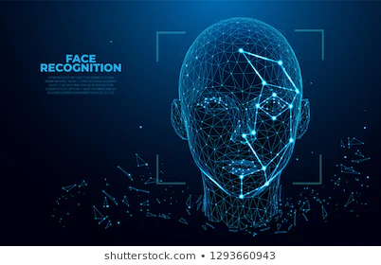
PROPOSED SYSTEM
We are going to propose the three layer security scheme to avoid the shoulder surfing and thermal tracking attacks. Our system contains the three layers which are
1.Face recognition

Slide 11
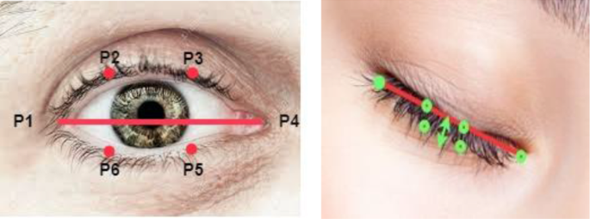

2. Eye- blink verification and OTP

Slide 12
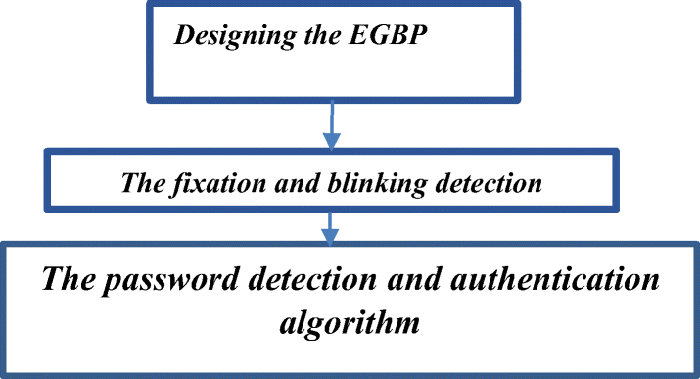
3. By combining all this layers we are going to implement our secure framework to avoid shoulder surfing and thermal tracking attacks. In our frame works there is no physical entry of password so we are completely avoiding the shoulder surfing and thermal tracking attacks. For the first layer security we are using Deep Learning algorithm., for the second layer we are using OpenCV.

Slide 13
METHADOLOGY
Face Recognition Using CNN:
Face recognition is actually a sequence of several related steps:
1. First, you need to look at the image and find all the faces on it
2. Secondly, it is necessary to focus on each face and determine that, despite the unnatural turn of the face or poor lighting, it is the same person.
3. Thirdly, it is necessary to highlight the unique characteristics of the face, which can be used to distinguish it from other people — for example, the size of the eyes, the elongation of the face, etc.
4. In conclusion, it is necessary to compare these unique characteristics of the face with the characteristics of other people you know to determine the name of the person.

Slide 14
Eye Blink Password Generation:
This is the second layer authentication in our project we are displaying the digital keyboard on the screen. One cursor will keep moving in the digital numeric keyboard when user blinks eye system will generate the PIN number from collect the sequence of numbers which user blinks eye. we are using the web camera to monitor eye moments. We are using OpenCV to detects eye blink.We are going to build upon this knowledge and develop a computer vision application that is capable of detecting and counting blinks in video streams using facial landmarks and OpenCV.To build our blink detector, we’ll be computing a metric called the eye aspect ratio (EAR).

Slide 15
Unlike traditional image processing methods for computing blinks which typically involve some combination of:
1. Eye localization.
2. Thresholding to find the whites of the eyes.
3. Determining if the “white” region of the eyes disappears for a period of time (indicating a blink).
4. The eye aspect ratio is instead a much more elegant solution that involves a very simple calculation based on the ratio of distances between facial landmarks of the eyes.

Slide 16
OTP Generation and Verification:
This is the third level of security we are using the random numbers to generate the otp and send to users email/ mobile number using the otp we can secure our accounts.

Slide 17
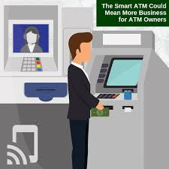
TOOLS AND TECHNOLOGY
Hardware requirement:
Processor Type : Intel Core TM – i5
• Speed : 2.4 GHZ
• RAM : 8 GB RAM
• Hard disk : 80 GB HDD
Software requirement:
Operating System : Windows 64-bit
• Technology : Python
• IDE : Python IDLE
• Tools : Anaconda
• Python Version : Python 3.6

Slide 18
CONCLUSION
Real-time eye and iris tracking is important for hands off gaze-based password entry, instrument control by paraplegic patients, Internet user studies, as well as homeland security applications. Eye detection refers to finding eye features in a single frame. Eye tracking is achieved by detecting the same eye features across multiple image frames and correlating them to a particular eye.
The algorithms are tested for eye detection and tracking under different conditions including different angles of the face, head motion speed, and eye occlusions to determine their usability for the proposed applications.

Slide 19
SCOPE
The scope of the project is to provide a researchers proposed a three layered security framework to secure PIN numbers, where users can enter the password by blinking the eye at the suitable symbols in the appropriate order and thus the user is invulnerable to shoulder surfing.

Slide 20


